Slide 1


ARTIFICIAL
INTELLIGENCE
Applications and its Future
A.I.
Big Data
Images
Videos
IoT
Audios
Texts
Dr. Jia-Wei Chang
jwchang@nutc.edu.tw
jiaweichang@mail.ncku.edu.tw

Slide 2
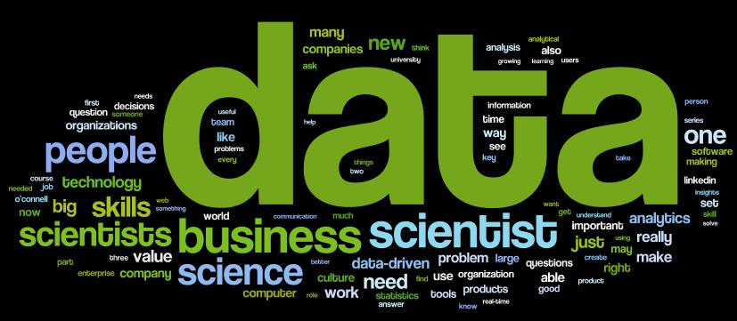

About Me
[Since Jan. 2019] Young Professionals Chair, IET Taipei Local Network.
[Since Dec. 2017] Consultant, NEXCOM Industry 4.0 Center.
[Jan. 2017] Ph.D. degree, National Cheng Kung University.
Work Experience
2022/2 ~ Now
Associate Professor
2018/8 ~ 2021/1
Assistant Professor
National Taichung University of
Science and Technology
2018/2 ~ Now
Adjunct Assistant Professor
National Cheng Kung University
Research Topics
Natural Language Processing
Natural Language Understanding
Chatbot
Text Summarization / Classification
Deep Learning
Data Mining
Internet of Things
Smart Speaker

Slide 3
Keywords
Data to Intelligence
Natural Language Processing Lab, National Taichung University of Science and Technology

Slide 4
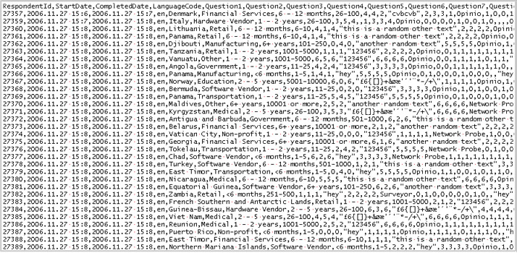
Data?
Natural Language Processing Lab, National Taichung University of Science and Technology

Slide 5
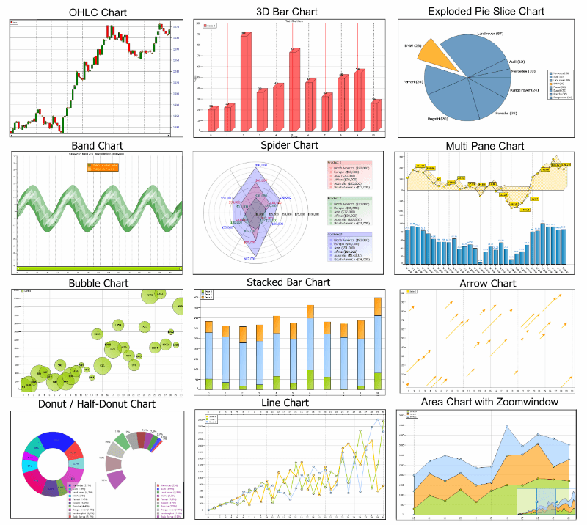
Information?
Natural Language Processing Lab, National Taichung University of Science and Technology

Slide 6




Keywords
Intelligence
Decision Making, Reasoning
Analysis, Judgement
Creativity, Thinking
Data
Information
Knowledge
Intelligence
Knowledge
Integration of Information, Experience, and Cultures
Specific Domain
High Expertise
Information
Data with preprocessing
Meaningful / Useful Clues
Data
Raw Records
Meaningless
Lack of organization or classification
Natural Language Processing Lab, National Taichung University of Science and Technology

Slide 7
Types
Natural Language Processing Lab, National Taichung University of Science and Technology

Slide 8
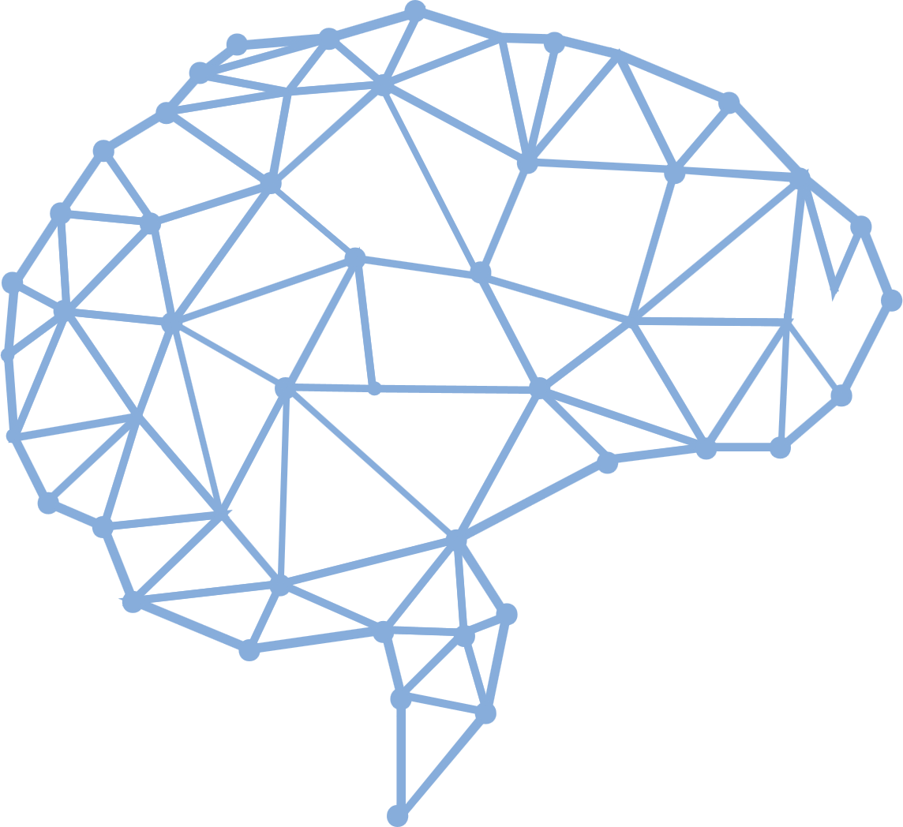
Types of A.I.
Strong A.I.
Make it smart likes a human beings.
Strong A.I. is expected to do anything that human can do. It is an AI-complete or AI-hard problem.
Weak A.I.
Make it to solve a specific problem.
For example, Chatbot or Object Detection.
Natural Language Processing Lab, National Taichung University of Science and Technology

Slide 9

IBM Watson
Natural Language Processing Lab, National Taichung University of Science and Technology

Slide 10
The Most Famous A.I. - AlphaGo
Natural Language Processing Lab, National Taichung University of Science and Technology

Slide 11



The Most A.I. We Can See
Natural Language Processing Lab, National Taichung University of Science and Technology

Slide 12
Applications
A.I. Everywhere
Natural Language Processing Lab, National Taichung University of Science and Technology

Slide 13
A.I. Can Appear Everywhere
Social network applications
Marketing applications
Robots
Factories
Financial industry
Medicals
Chatbot
Car driving
Search engines
Natural Language Processing Lab, National Taichung University of Science and Technology

Slide 14



SEARCH ENGINES
Natural Language Processing Lab, National Taichung University of Science and Technology

Slide 15


MARKETING APPLICATIONS
Natural Language Processing Lab, National Taichung University of Science and Technology

Slide 16



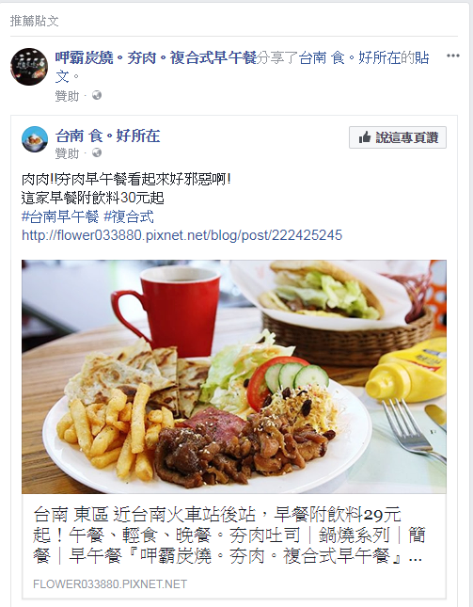
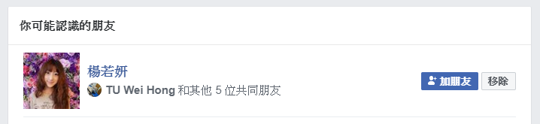



SOCIAL NETWORK APPLICATIONS
Natural Language Processing Lab, National Taichung University of Science and Technology

Slide 17
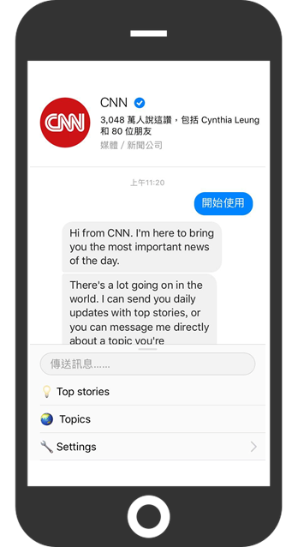
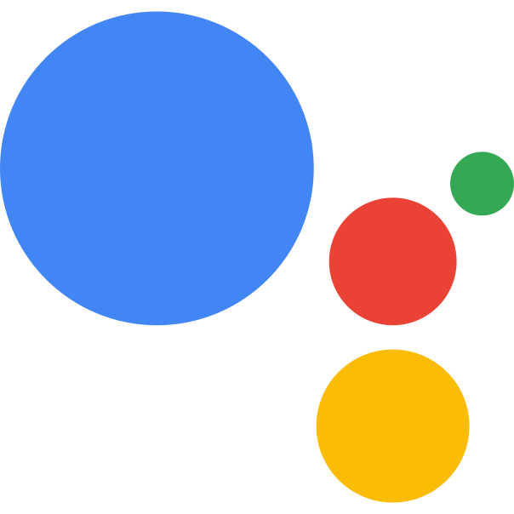

CHATBOT
Siri
Google Assistant
Natural Language Processing Lab, National Taichung University of Science and Technology

Slide 18

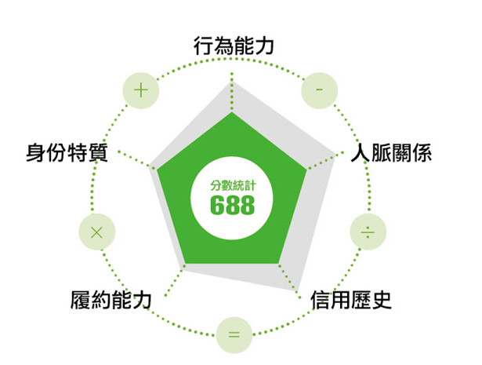
FINANCIAL INDUSTRY
Natural Language Processing Lab, National Taichung University of Science and Technology

Slide 19
AI FOR MEDICAL
醫療影像
Google、IBM、
騰訊、阿里、Intel
醫院管理
Qventus、CloudMedx
醫學研究
IBM、Microsoft、Hanover
輔助診療
IBM、百度
AI
醫療
健康管理
碳雲智能、 Validic、Evolent Health
藥物開發
IBM、BenevolentAI、Insilico Medicine
精準醫療
華大基因、Flatiron、Deep Genomics
虛擬助理
Microsoft、科大訊飛、Sense.ly
Natural Language Processing Lab, National Taichung University of Science and Technology

Slide 20
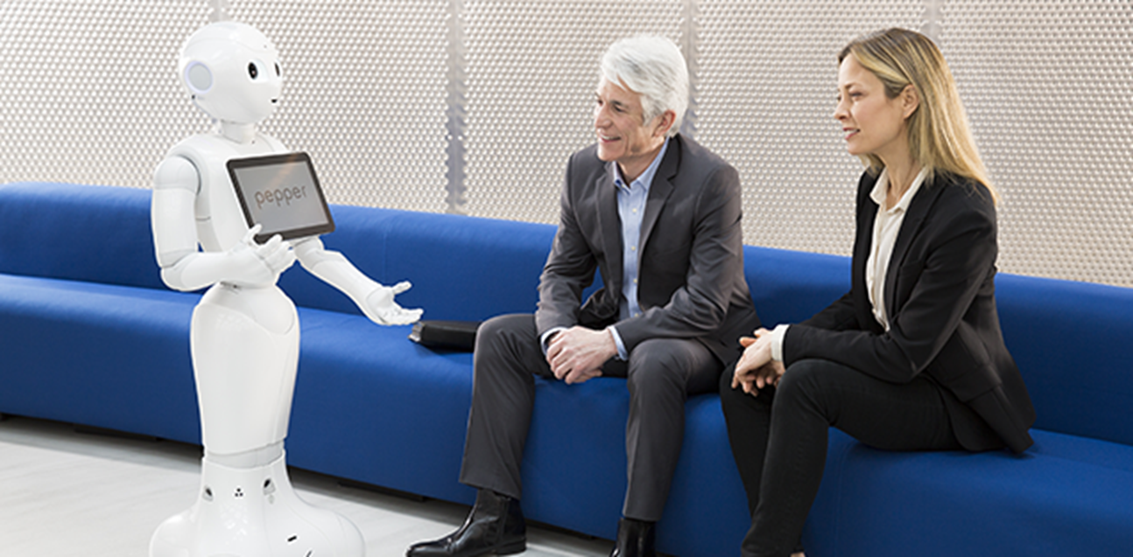
ROBOTS
Natural Language Processing Lab, National Taichung University of Science and Technology

Slide 21
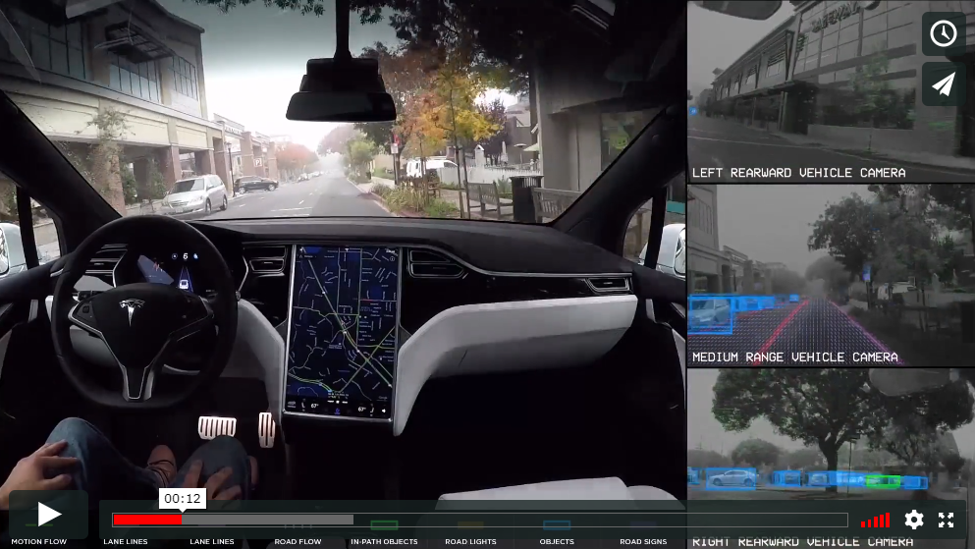
CAR DRIVINGS - Autopilot
Natural Language Processing Lab, National Taichung University of Science and Technology

Slide 22
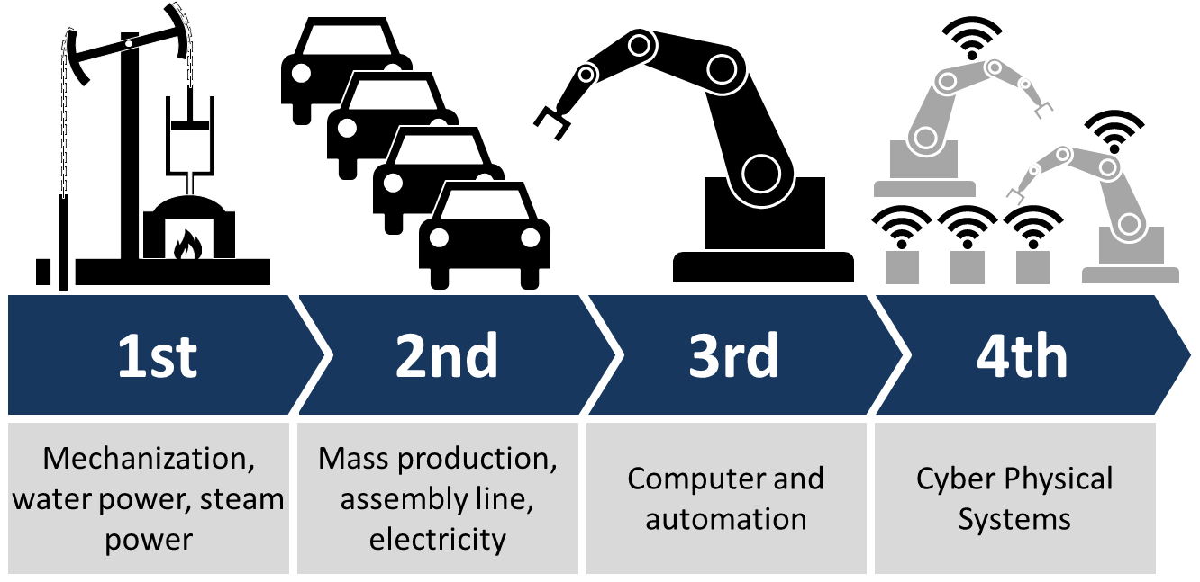
Industry 4.0
Natural Language Processing Lab, National Taichung University of Science and Technology

Slide 23
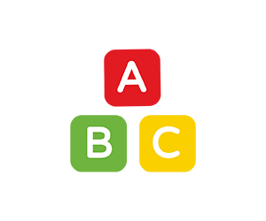





Data Driven Applications
Texts
Natural Language Processing
Categories
Audios
Signal Processing
Values
Data
Types
Images, Videos
Computer Vision
Networks
Internet of Things
Time Series

Slide 24
Methodology
Natural Language Processing Lab, National Taichung University of Science and Technology

Slide 25
A.I. History
1950-1960
1990-Now
2020-Future
Symbolicism
Machine Learning
What’s Next?
Where is Intelligence?
Thinking & Logic
Data
Perceptron,
1957-1962
SVM,
1995
Backpropagation & Convolution,
1980s
1980-1990
2006-Now
Expert Systems
AlphaGo, 2016
Deep Learning
Domain Knowledge
Data & Features
Natural Language Processing Lab, National Taichung University of Science and Technology

Slide 26
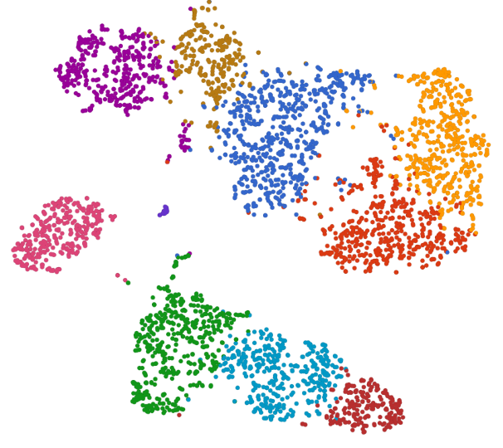


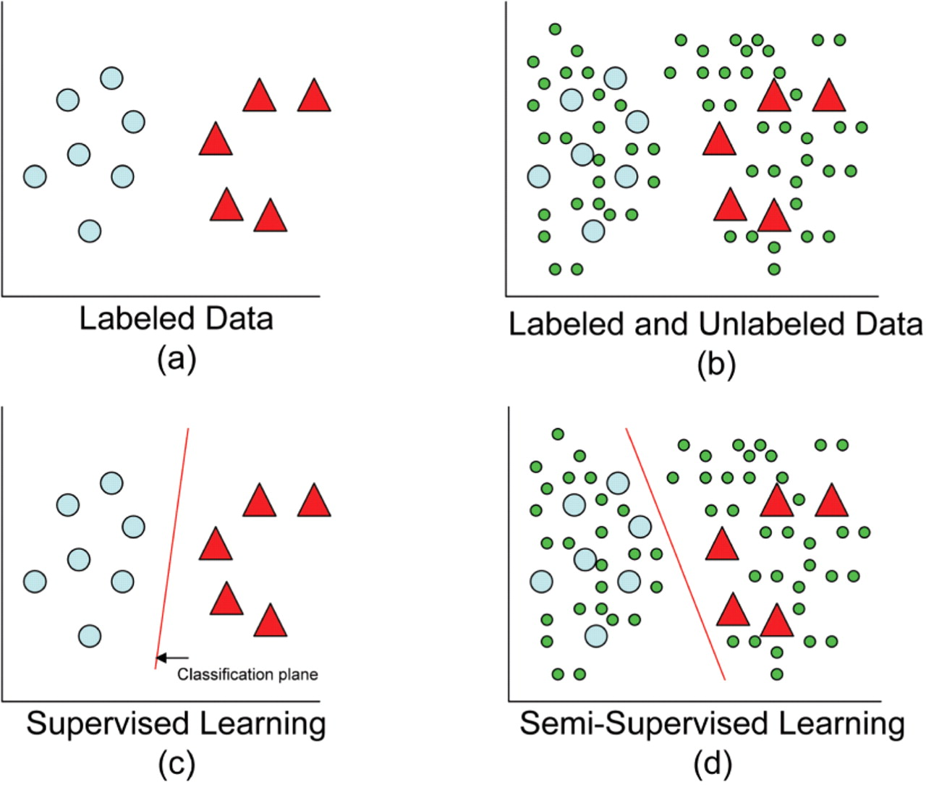


A.I. Methodology
Unsupervised Learning
Semi-supervised Learning
Discover the similarities between data.
Make the similar ones to be a group. Separate unsimilar groups as possible.
First train a supervised learning model, and then retrain the model to improve its robustness by unlabeled data.
Supervised Learning
Reinforcement Learning
Classify data into multiple categories.
Learn the identification rules from data and its labels.
First set reasonable rewards of game rules to the RL model, and then train the model via trial and error.
Reference:
https://academic.oup.com/bioinformatics/article/24/6/783/193709
https://documentation.partek.com/display/FLOWDOC/Graph-based+clustering

Slide 27
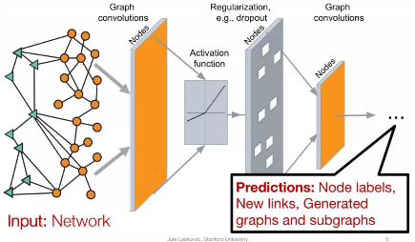
Evolution
Graph Neural Networks !?
Given input data in the form of Network.
Predict the node labels, new links and so on.
Reinforcement Learning
Q-learning
Deep Q Networks
RL in Deep Learning
Deep Learning
Generative Adversarial Network
Convolutional Neural Network
Long Short-Term Memory
Artificial Neural Network
Machine Learning
Support Vector Machine (Class)
Decision Tree (Class)
Support Vector Regression (Value)
Linear Regression (Value)
Data Mining
Clustering
Classification
Association Learning
Reference:
https://static.aminer.cn/misc/pdf/graphsage2-mit-nov19.pdf

Slide 28

My Works with A. I.
from Past until Now
A.I. Projects
Just for fun – NBA Projects
Semantic Analysis
Chinese Menu Recognition
Robot Arm Control via Hand Movement Recognition
Extubation Prediction: Cases in ICU
Smart Speaker / Chatbot
A.I. Musician
A.I. Lawyer

Slide 29
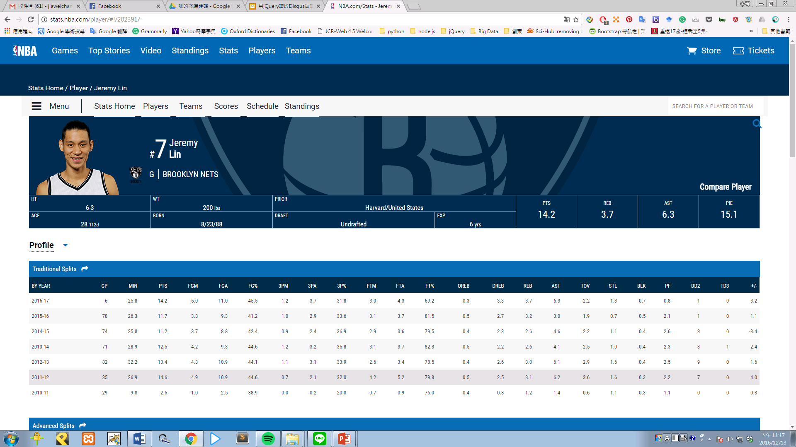
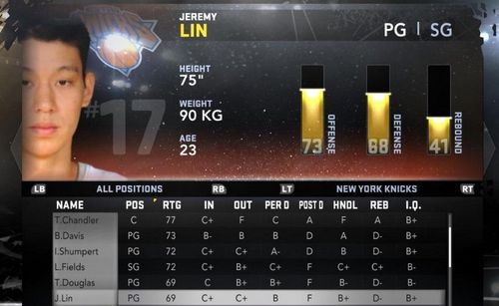
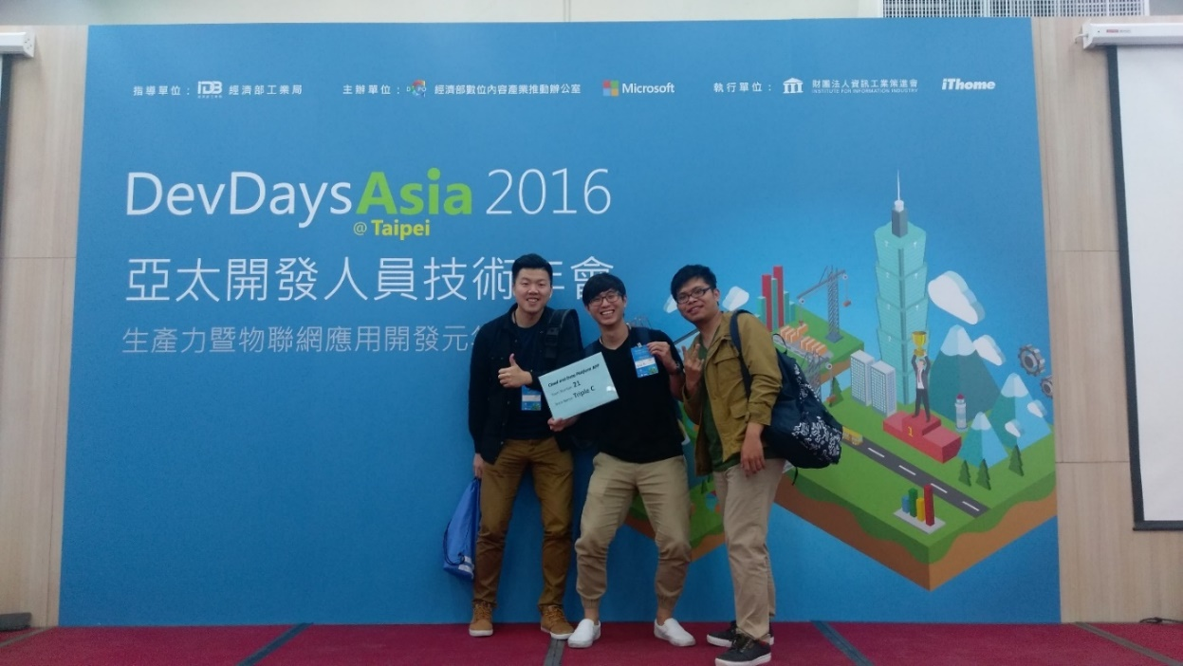
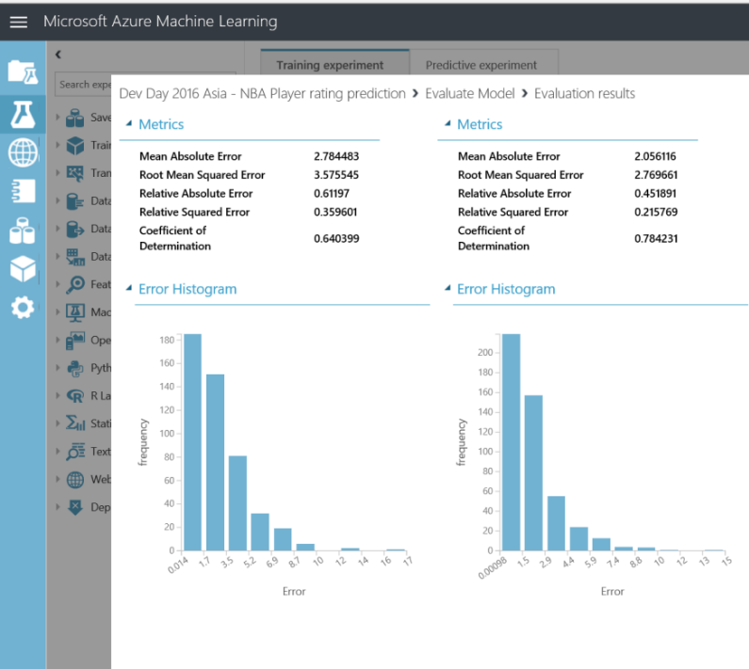
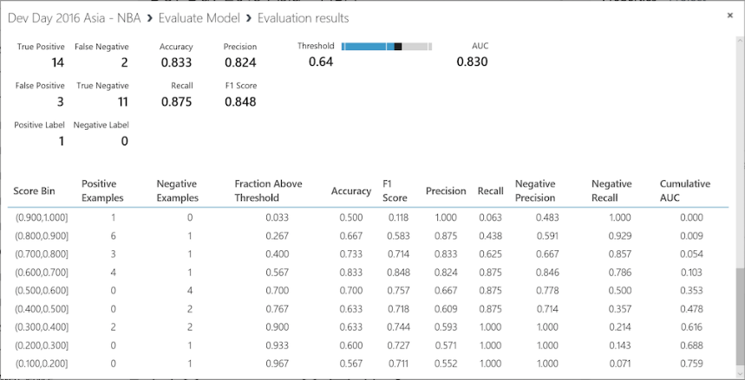
NBA Projects

Slide 30
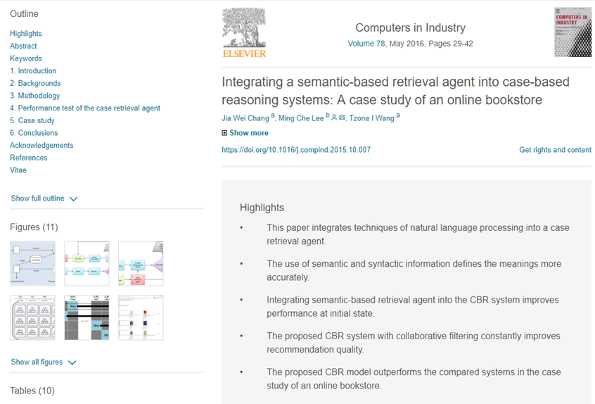
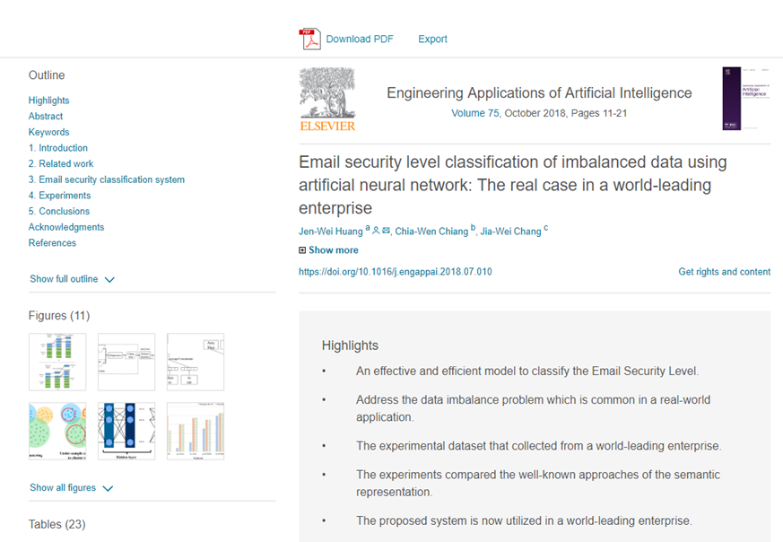
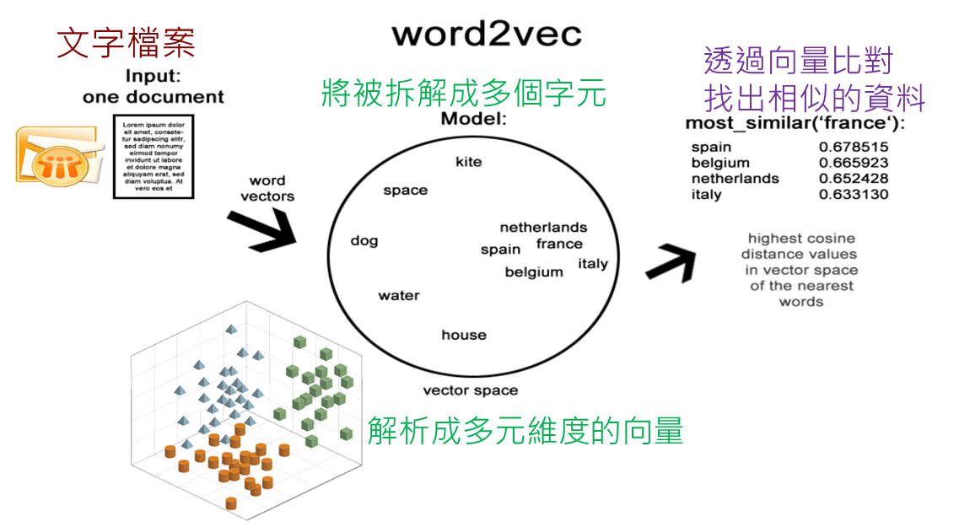
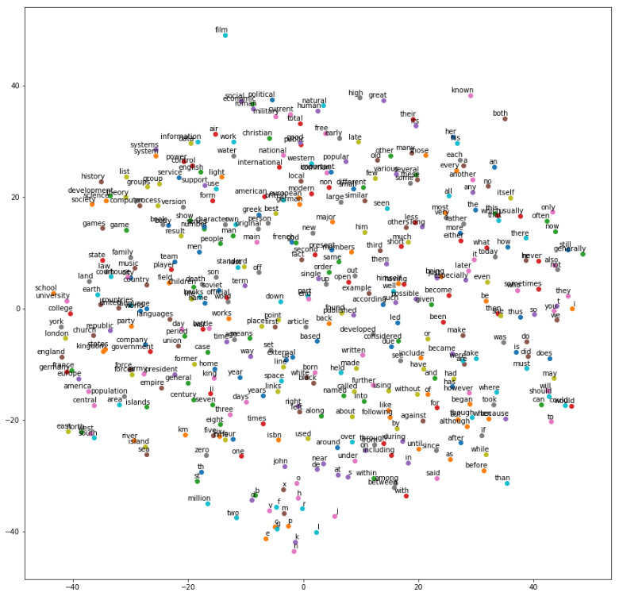
Semantic Analysis
Email Security Classification
Book Recommendation

Slide 31
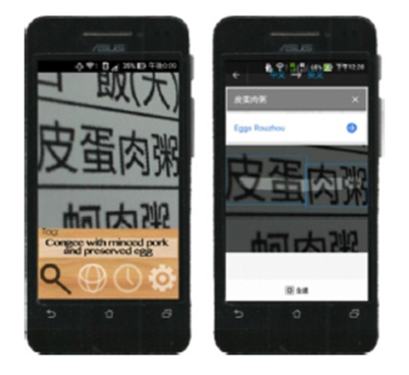
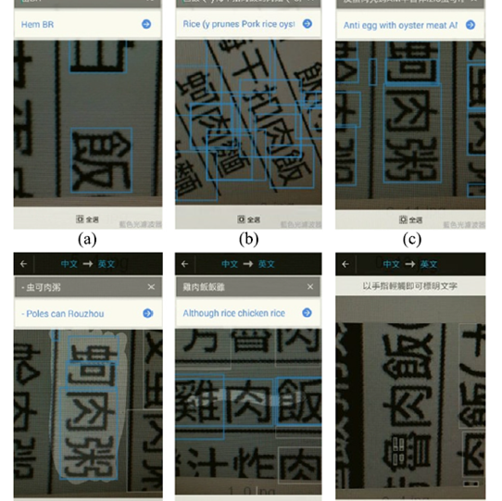
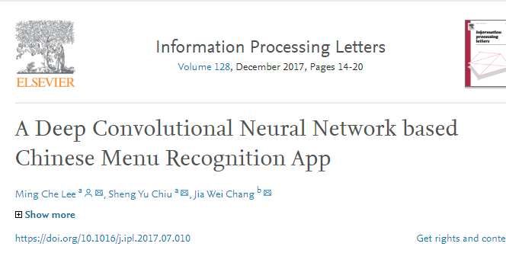
Chinese Menu Recognition
Lee, M. C., Chiu S. Y., & Chang, J. W. (2017) A Deep Convolutional Neural Network based Chinese Menu Recognition App. Information Processing Letters, 128, 14-20. https://doi.org/10.1016/j.ipl.2017.07.010
(SCI, COMPUTER SCIENCE, INFORMATION SYSTEMS)

Slide 32
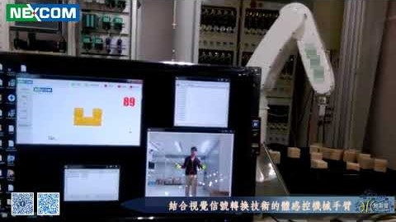
Robot Arm Control
via Hand Movement Recognition

Slide 33
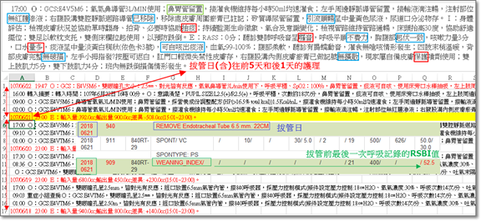
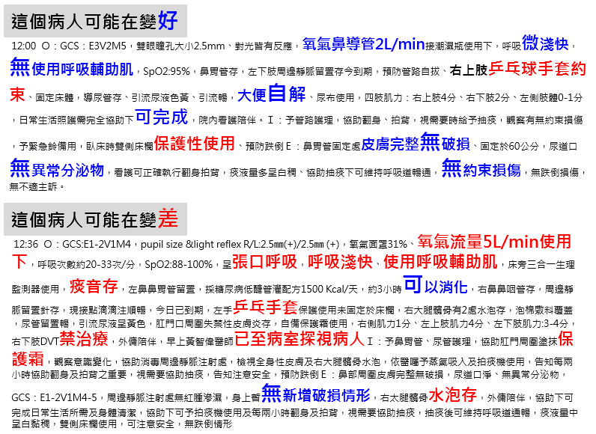
Extubation Prediction: Cases in ICU

Slide 34
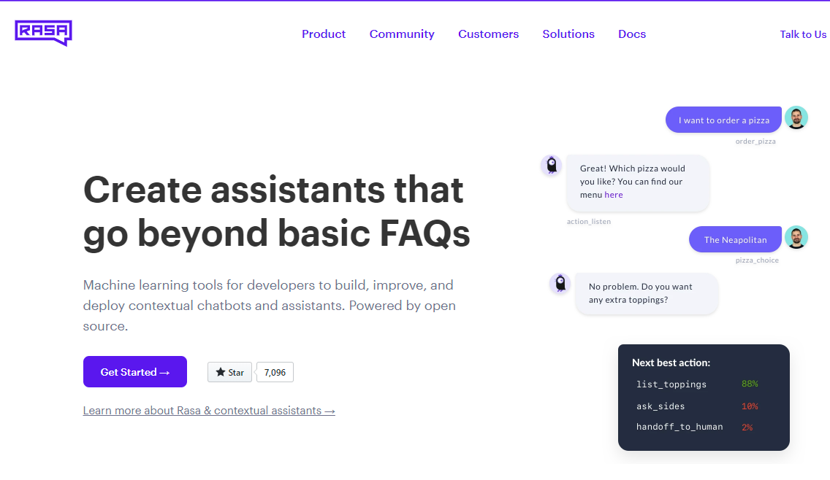
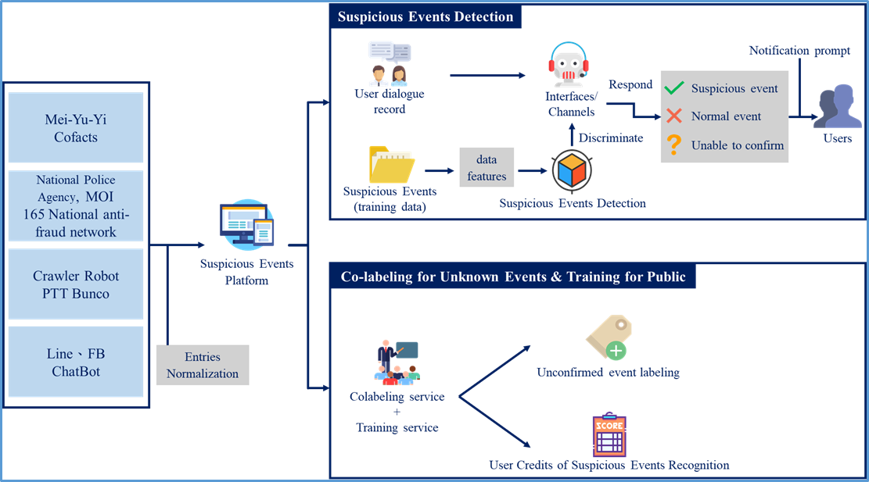
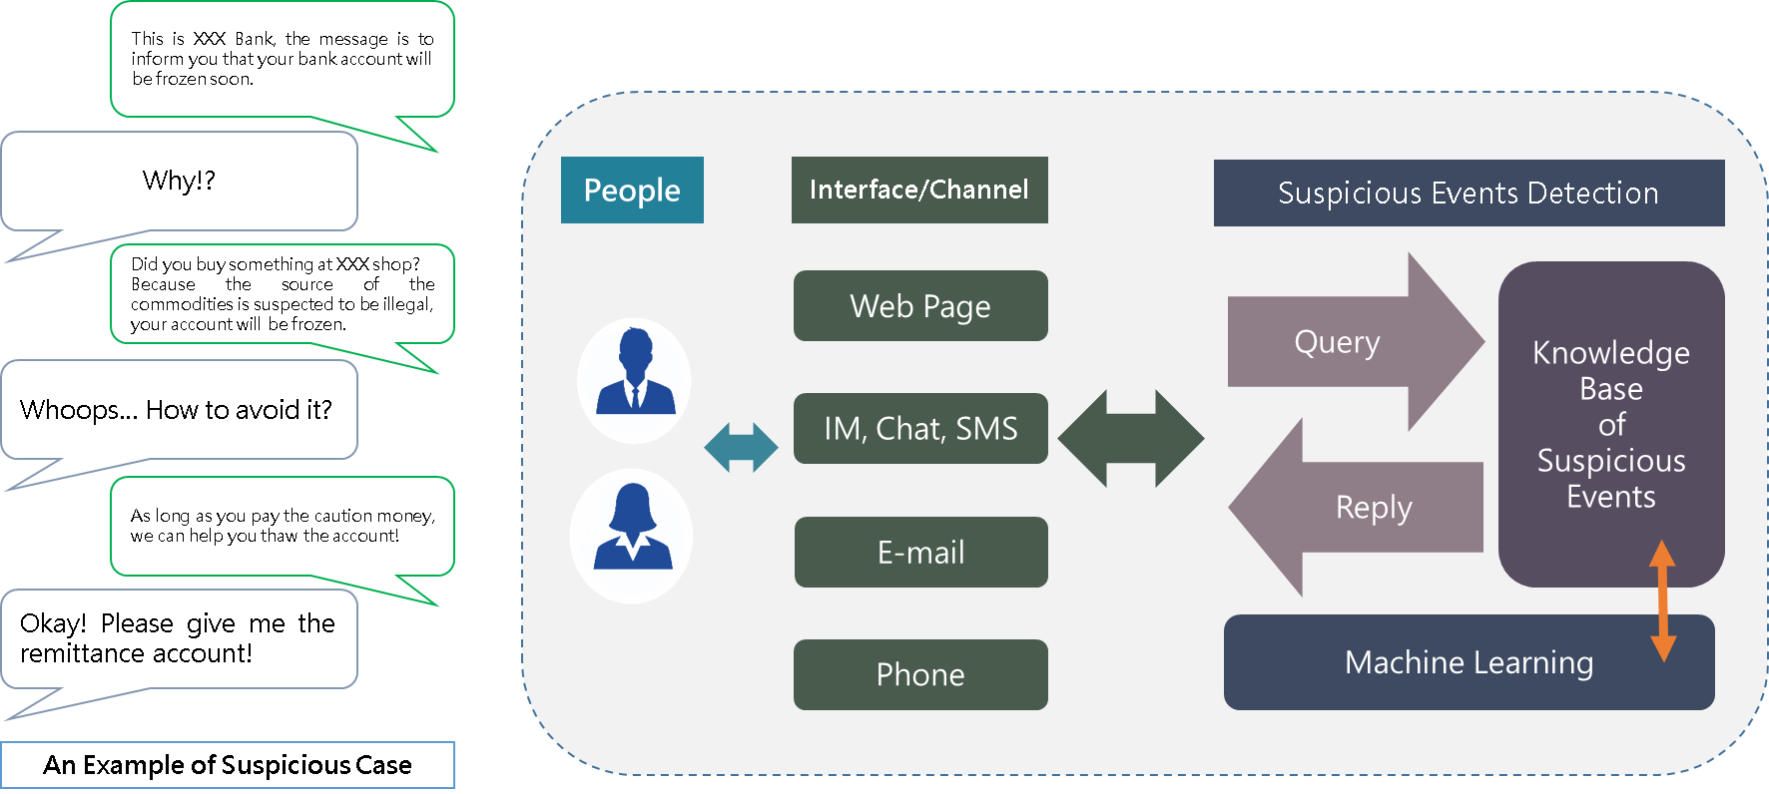
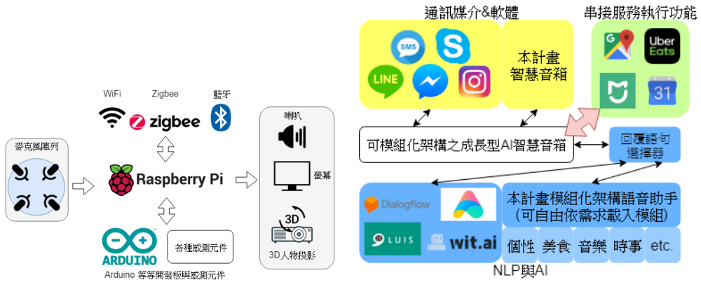
Smart Speaker / Chatbot

Slide 35
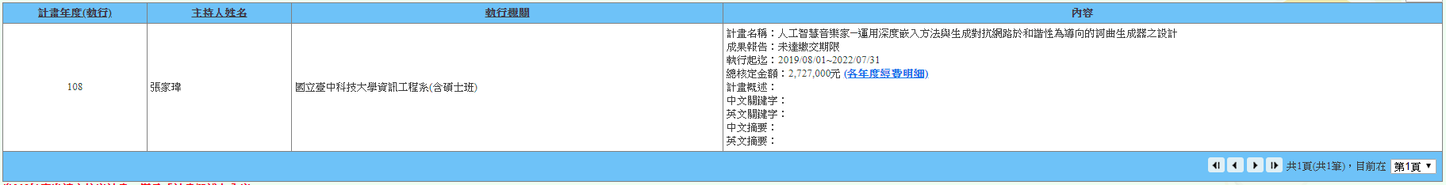
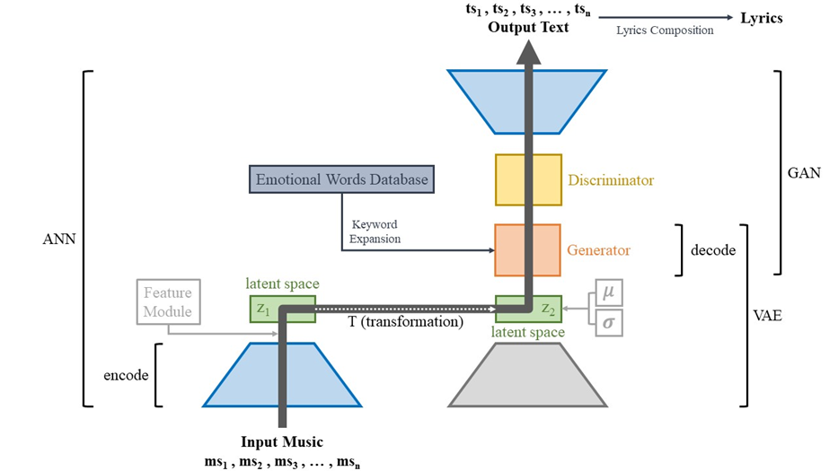
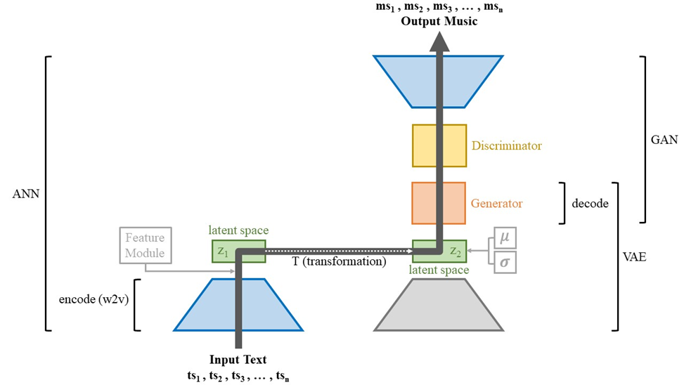
A.I. Musician

Slide 36
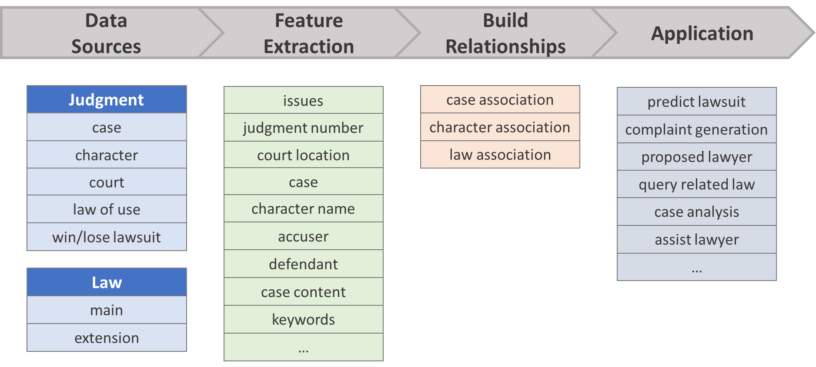

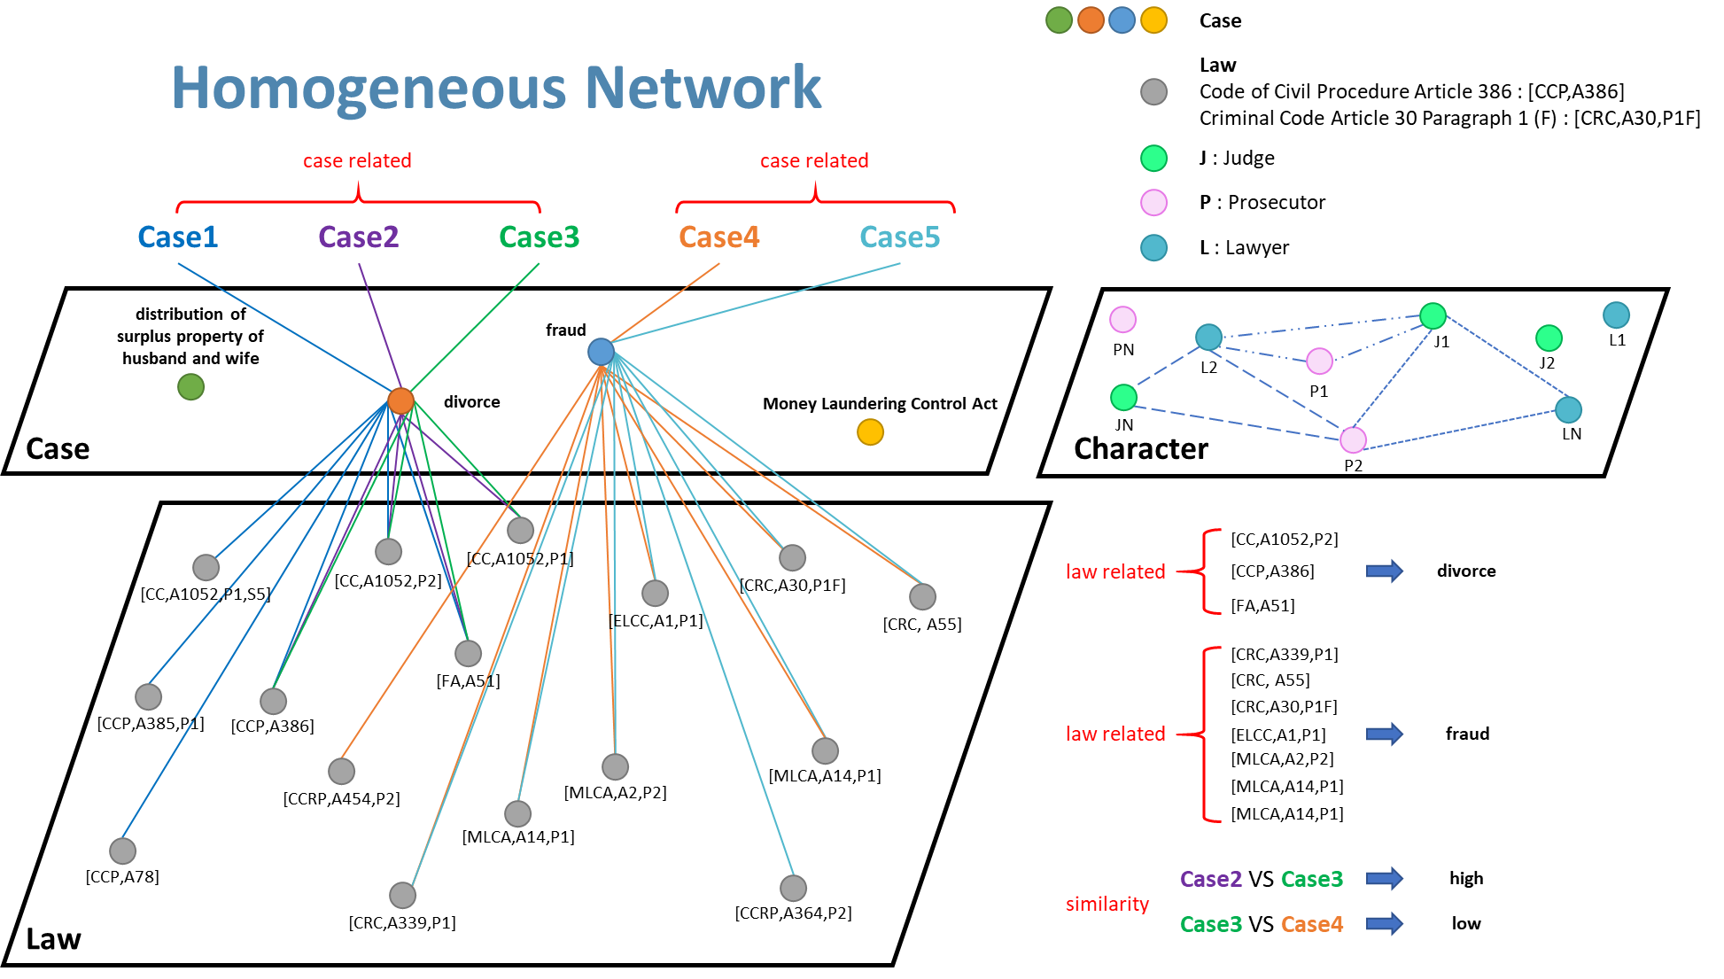
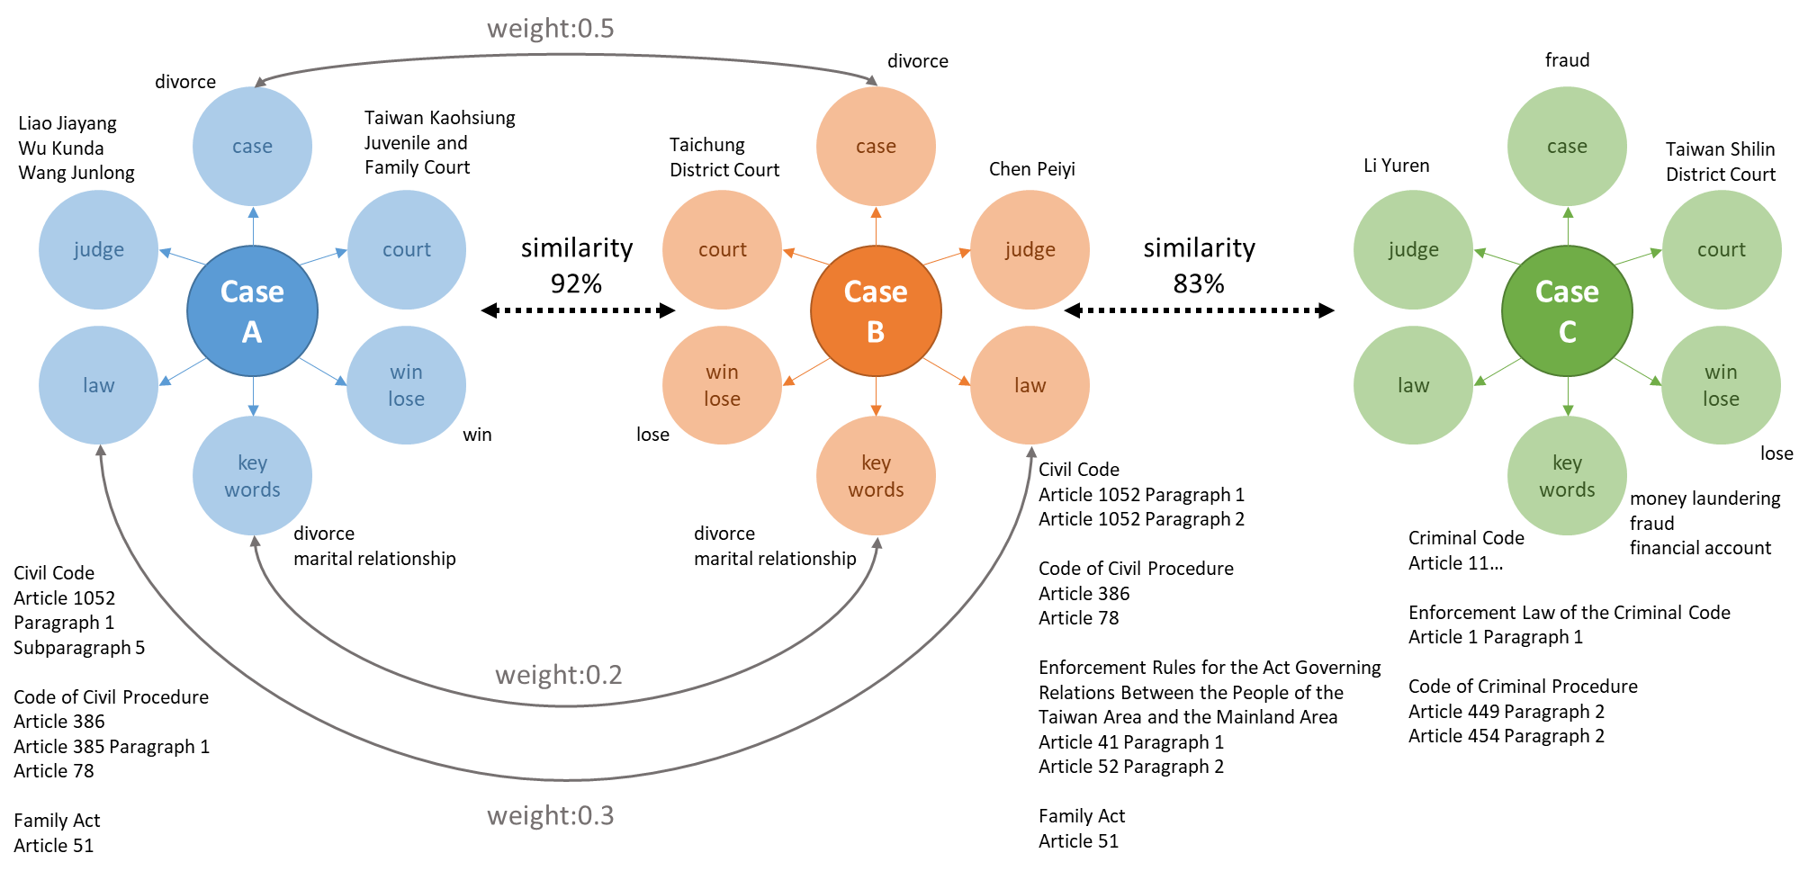
A.I. Lawyer

Slide 37

Artificial Intelligence
A.I. is not the GOAL !!!
A. I. cannot replace all the people.
A. I. only can replace the people who cannot use A. I.
A. I. can use to do
consuming manpower
dangerous
routine
boring
a specific task

Slide 38
Thank You

